Slide 1
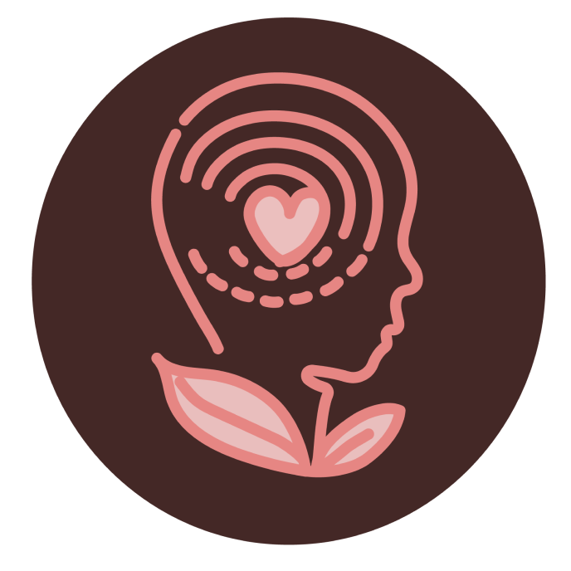


Slide 2
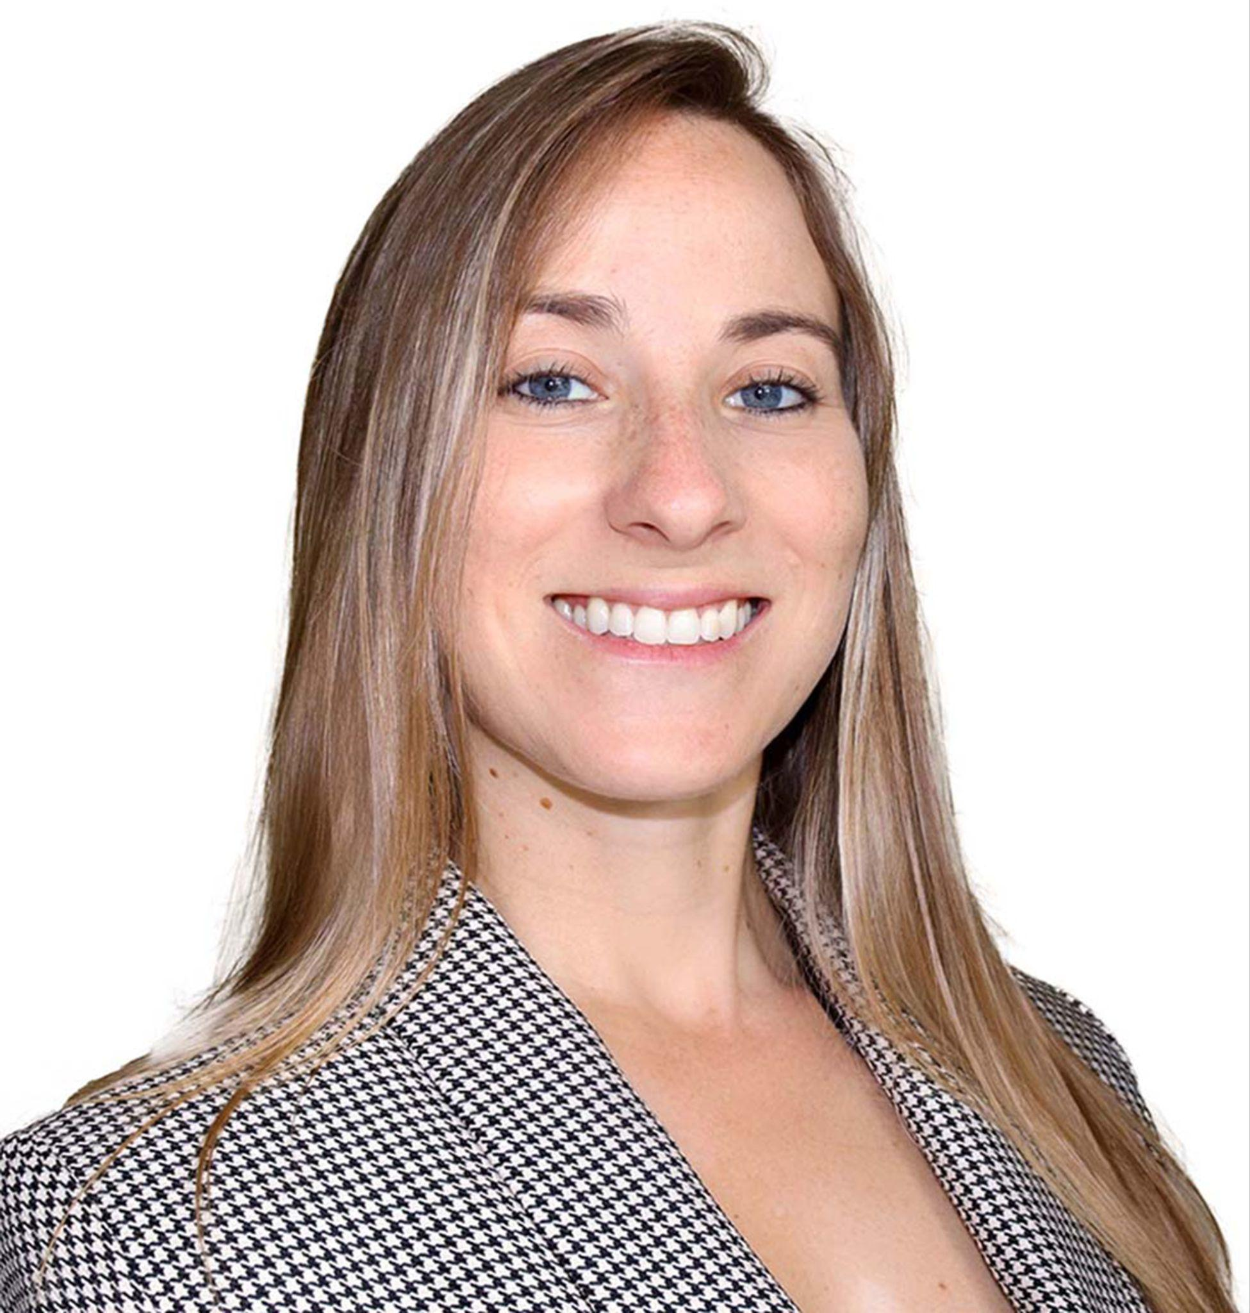




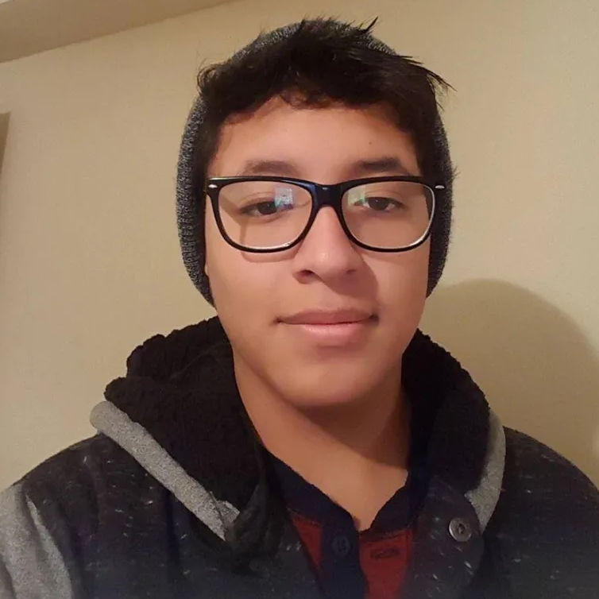
THE TEAM 4
Emily Gottlieb
UX Designer
Shivani Subramaniam
UX Designer
Jason Fong
Data Analyst
Rachel Cunningham
Software Engineer
Adama Walters
Software Engineer
Renato Vilcahuaman
Software Engineer

Slide 3
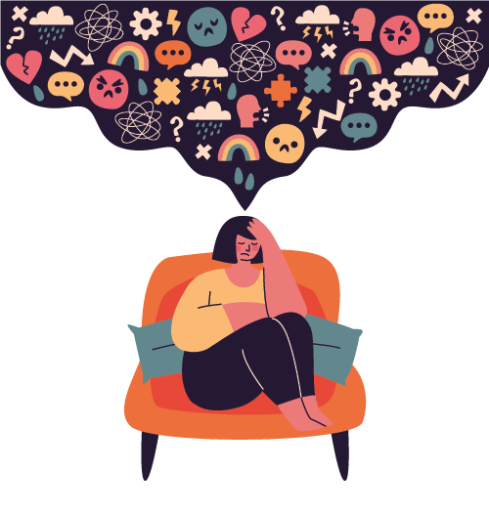
OVERVIEW
PROBLEM STATEMENT:
The mental health app sector is rapidly growing, fueled by increasing mental health awareness and the accessibility of technology.
Companies aim to incorporate apps into their wellness programs, recognizing that prioritizing employees' mental well-being directly correlates with boosting productivity.
Currently, there are no available apps or websites designed for companies to help them achieve this goal.

Slide 4
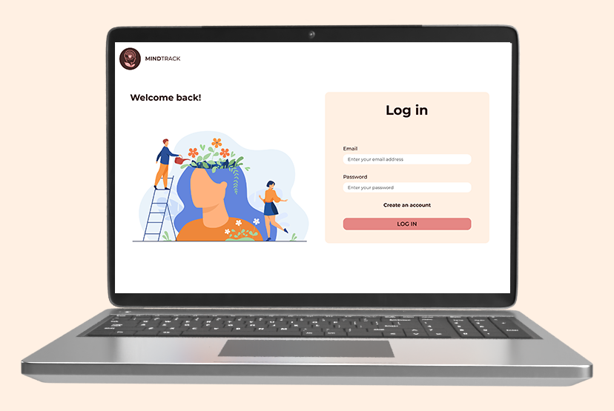
OVERVIEW
OUR SOLUTION:
We have created a user-friendly mental health website for companies, where their employees can track their mood, stress, and activity levels. Users can also receive helpful suggestions to manage stress and support their mental well-being.

Slide 5
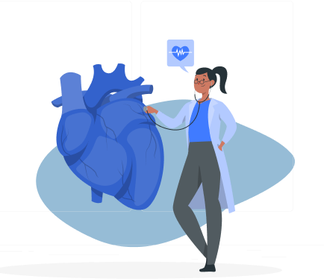
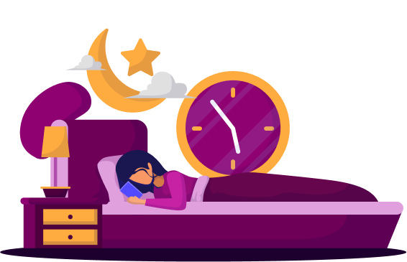
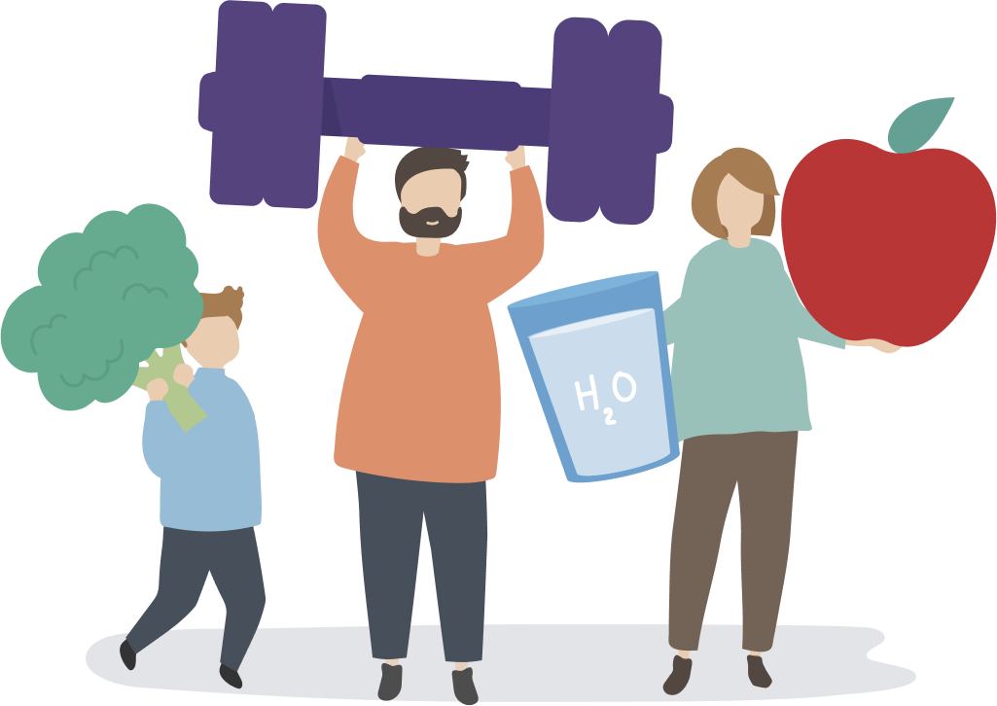
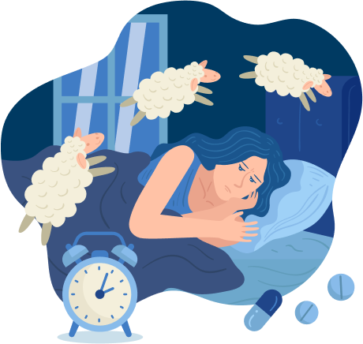
DATA
Link to dataset
The dataset is a comprehensive collection of data encompassing 400 entries and 13 distinct variables. It offers insights into various aspects of sleep and daily routines, shedding light on factors influencing sleep quality, lifestyle choices, and cardiovascular health. Here are the key metrics:
Sleep Metrics:
Sleep duration and quality
Lifestyle Factors: Physical level activities, stress levels, and BMI categories
Cardiovascular Health: Blood pressure and heart rate measurements
Sleep Disorder: Occurrences of sleep disorders such as Insomnia and Sleep Apnea

Slide 6
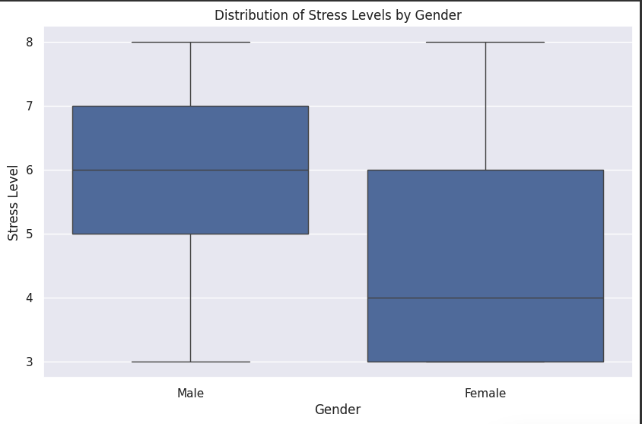
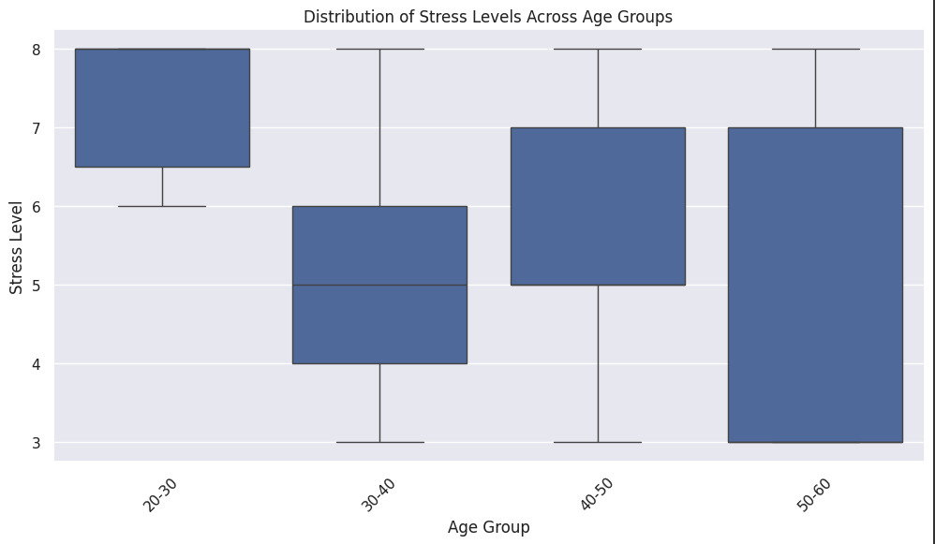
DEMOGRAPHIC ANALYSIS
Are there differences in stress levels between males and females, or across different age groups?
Stress levels vary across age groups, with the 20-30 age group reporting the highest average stress levels (7.32) and the 50-60 age group reporting the lowest (4.45). Generally, stress levels appear to decrease with age, with the youngest age group exhibiting the highest stress levels.

Slide 7
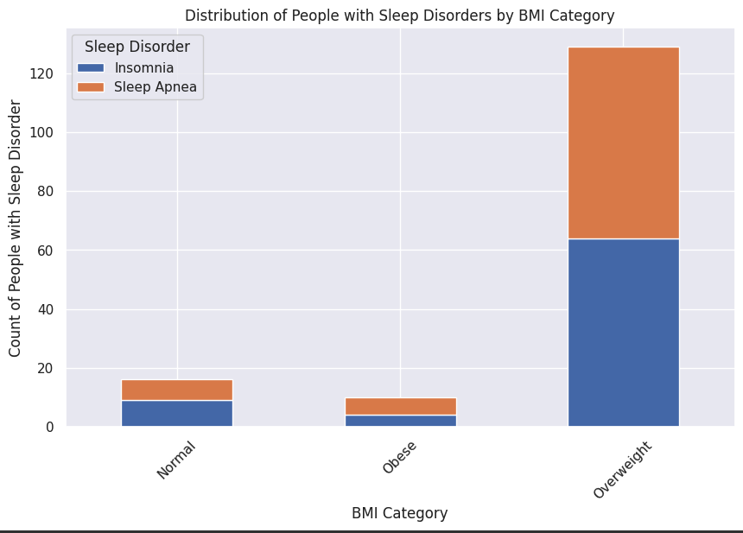
HEALTH AND LIFESTYLE ANALYSIS
Are individuals with higher BMI categories more likely to experience sleep disorders or higher stress stress levels?
Stress levels tend to increase slightly as BMI categories increase, with ‘Normal’ individuals experiencing a mean stress level of 5.13, ‘Obese’ Individuals at 5.7, and ‘Overweight’ individuals at 5.73. We also notice that individuals who are overweight/obese tend to experience more sleep disorders (insomnia or sleep apnea).
*There is a low count for obese individuals due to the fact that there aren’t there much obese individuals in our dataset.

Slide 8
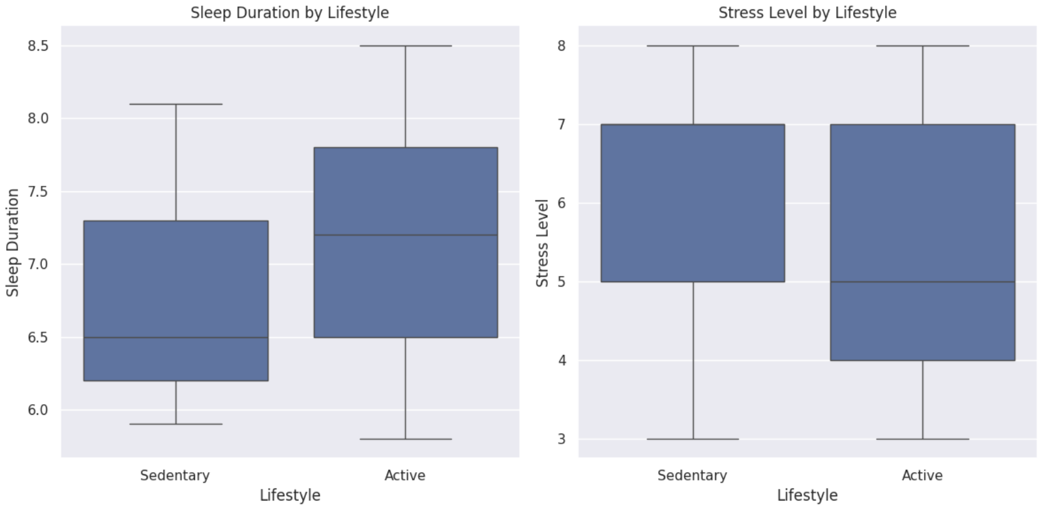
HEALTH AND LIFESTYLE ANALYSIS (cont)
Are there differences in sleep patterns or stress levels between individuals with sedentary lifestyles and those with more active lifestyles?
Individuals with sedentary lifestyles tend to have shorter sleep durations on average compared to those with active lifestyle. Additionally, sedentary individuals experience higher stress levels compared to their more active counterparts.

Slide 9
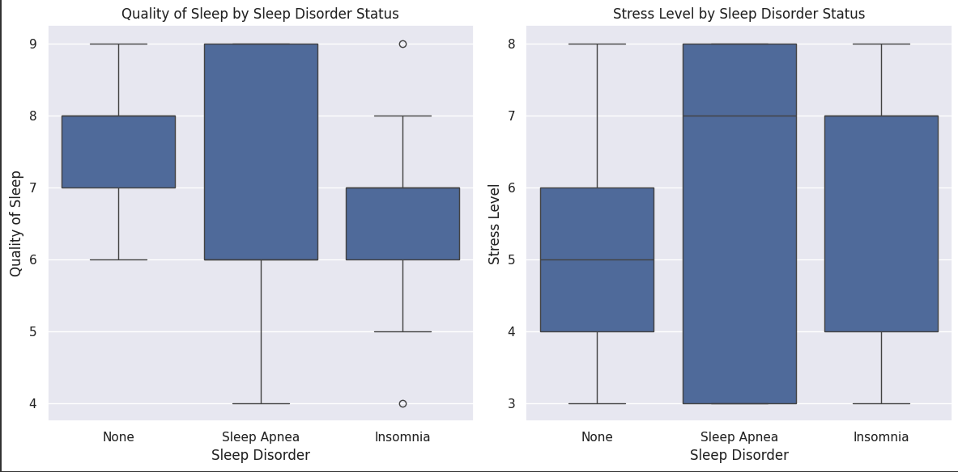
Sleep Patterns and Disorders
Do individuals with sleep disorders report lower sleep quality and higher stress levels compared to those without sleep disorders?
Individuals with sleep disorders tend to report lower quality of sleep and higher stress levels compared to those without sleep disorders. These results are statistically significant, as indicated by the very low p-values in our research.

Slide 10
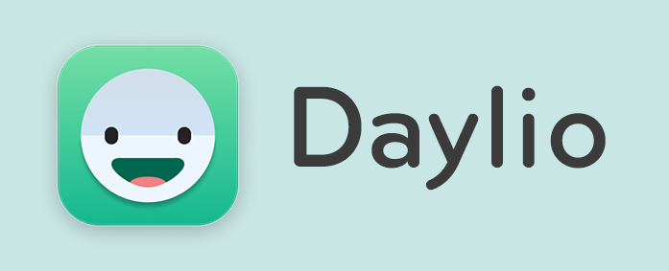
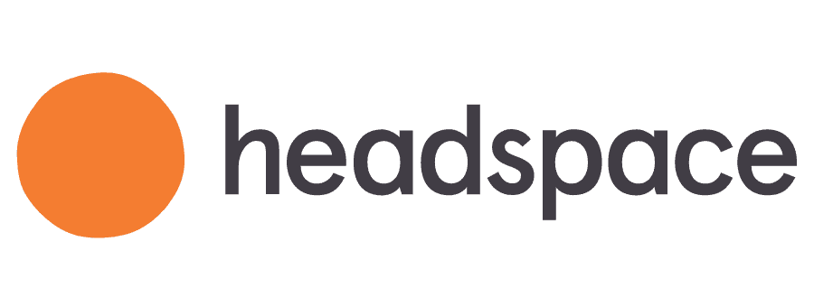
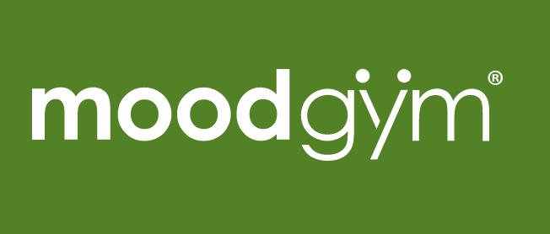
COMPETITIVE ANALYSIS
Customization options
Lack of insights for long term
Opportunity to provide guided meditation
High-quality mindfulness content
No options to personalize strategies
Opportunity to provide tracking progress
Structured programs
Very complex strategies
Opportunity to personalize the user page

Slide 11
SURVEY
92%
78%
Based on the data analysis and competitive analysis, we created and deployed a survey to our communities:
Questions about
demographics
employment status,
their mental health
how likely they are to use a mental health app
what they would want from one
indicated they were employed and had poor mental health
indicated that they are likely to use a mental health app for tracking their mood and personal strategies
85%
72%
had a preference for mood tracking functionality in a mental health app.
indicated that they would find personalized tips and coping strategies helpful
60%
indicated that other health metrics would also be helpful to see in conjunction (sleep & physical activity)

Slide 12
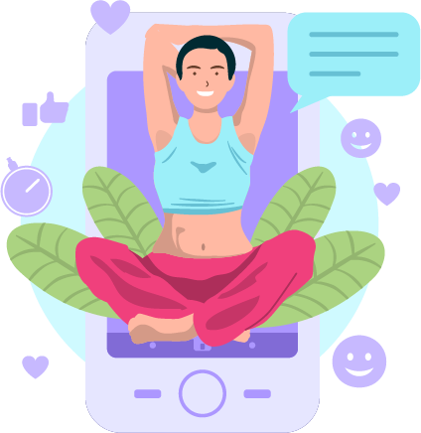
USER STORIES
Pain Points based on User Stories:
As a user:
Input current metrics
Track past metrics
Coping strategies
As an administrator:
Delete employees
Add new employees

Slide 13
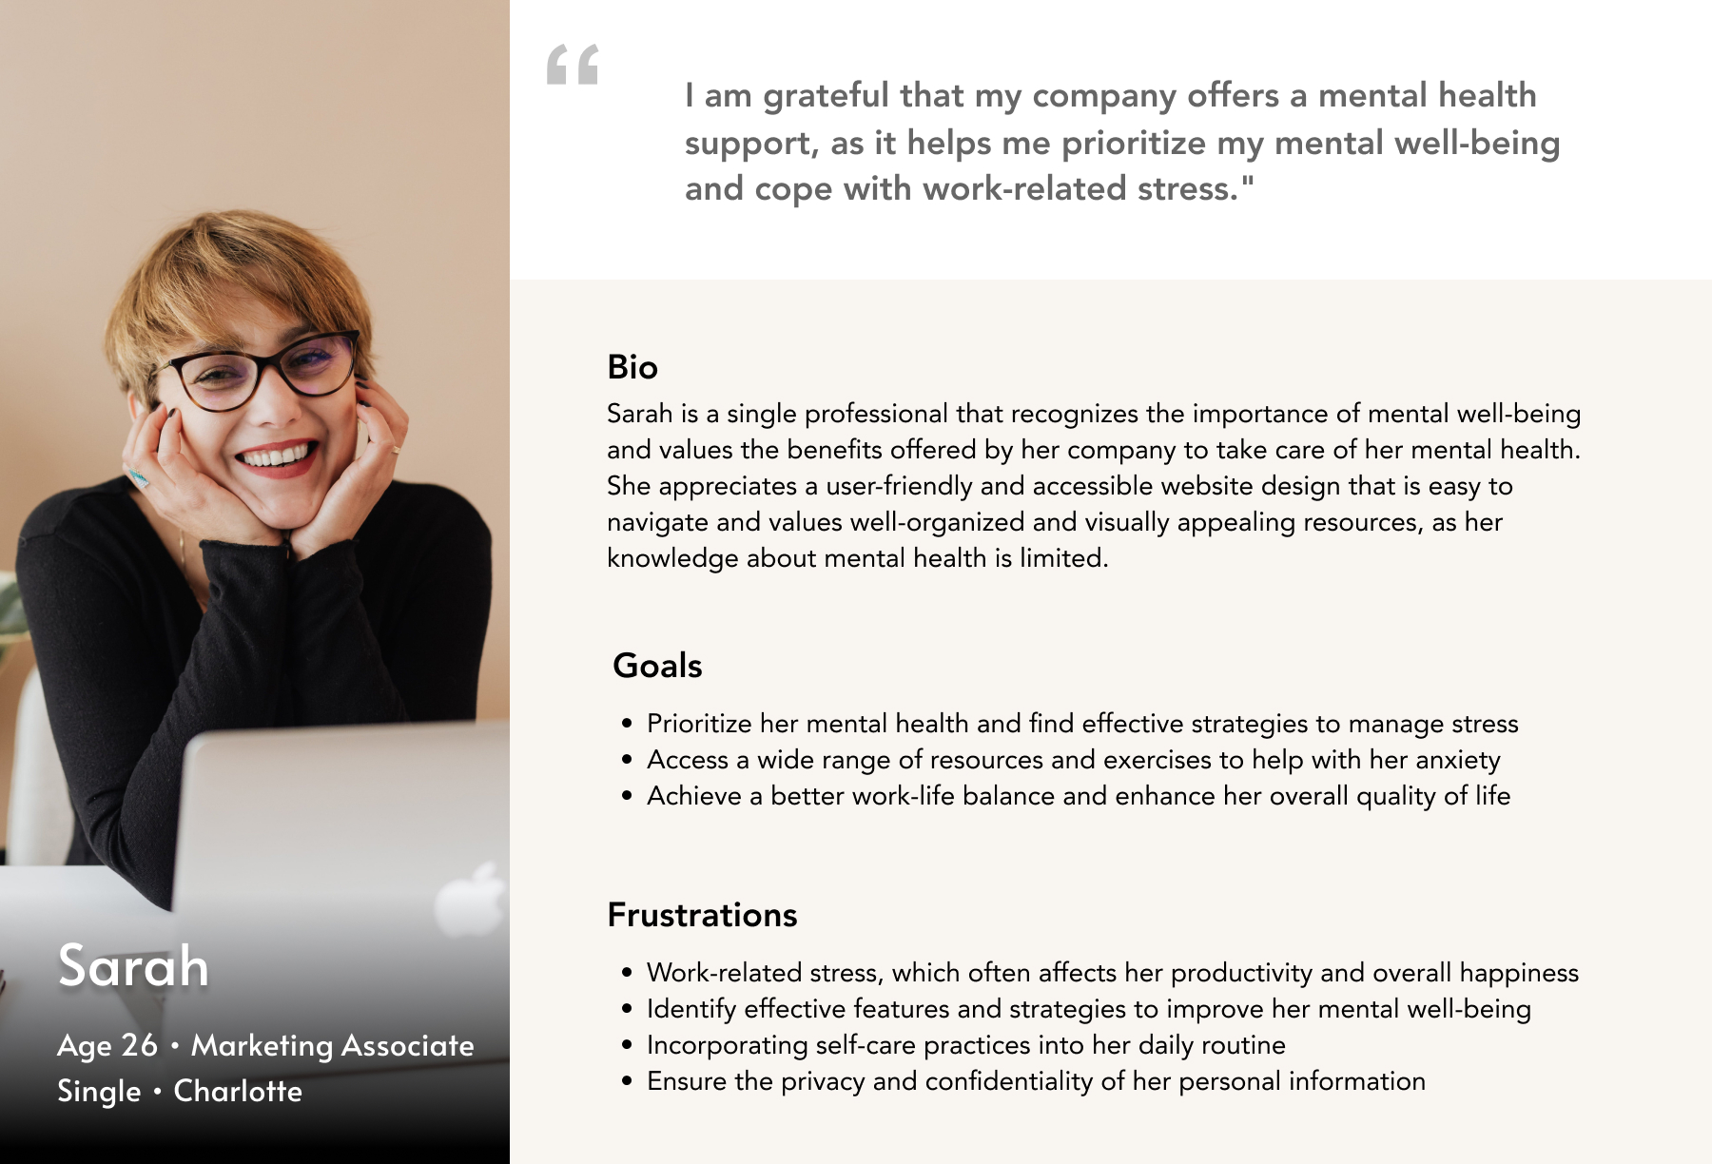
PERSONAS

Slide 14
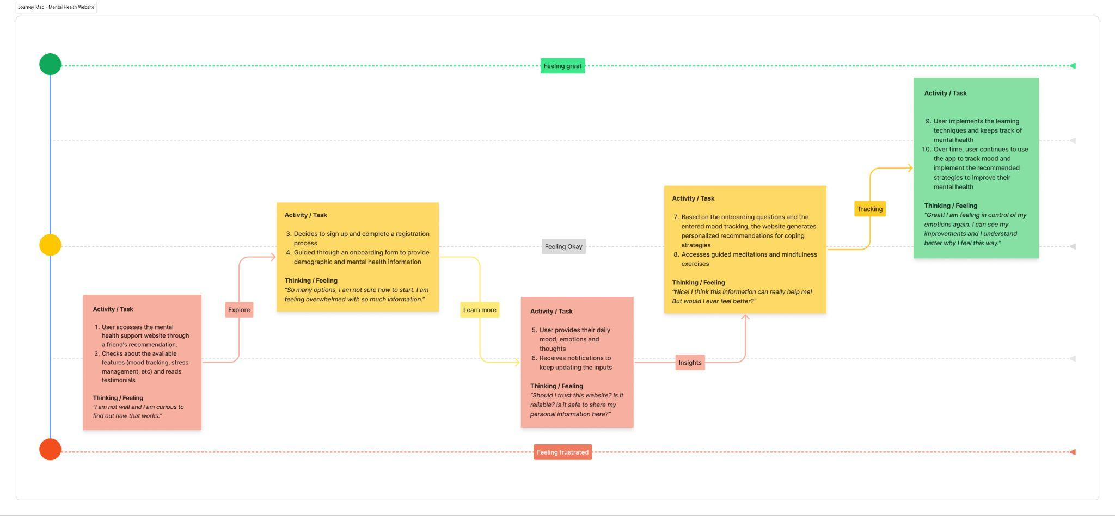
USER JOURNEY

Slide 15
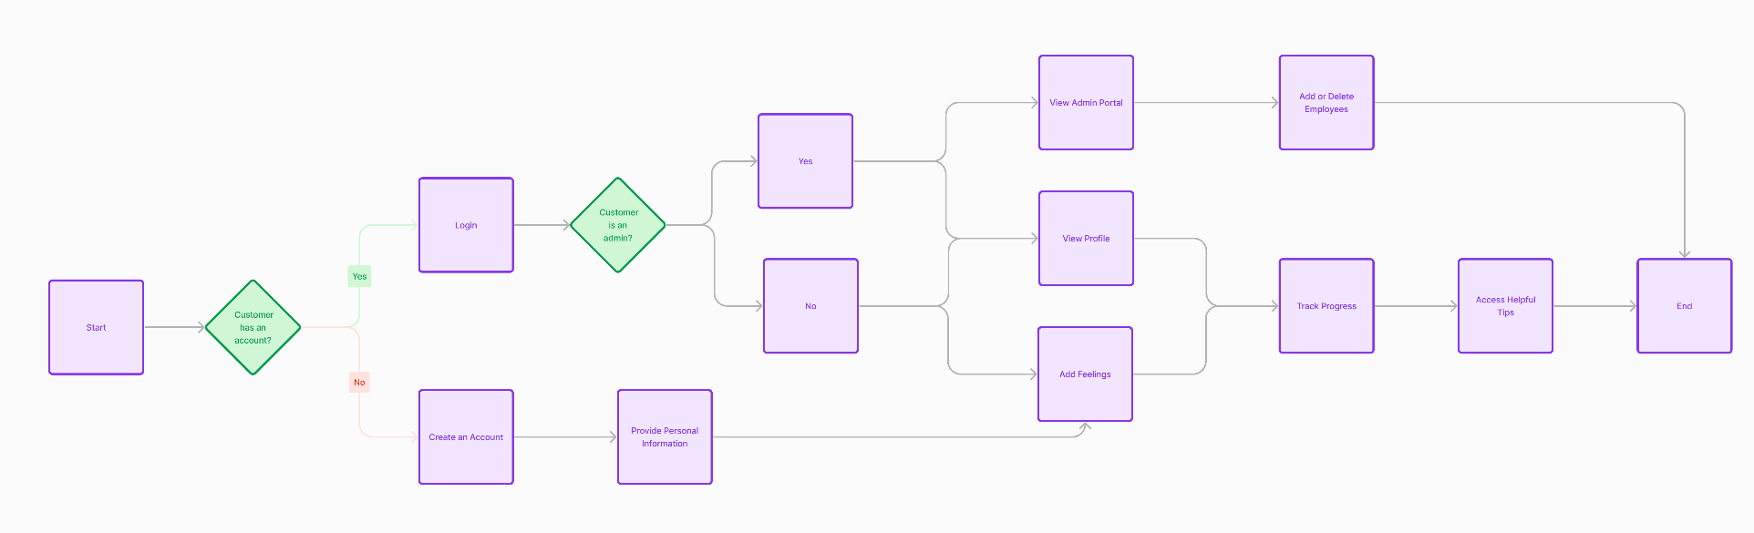
USER FLOW

Slide 16
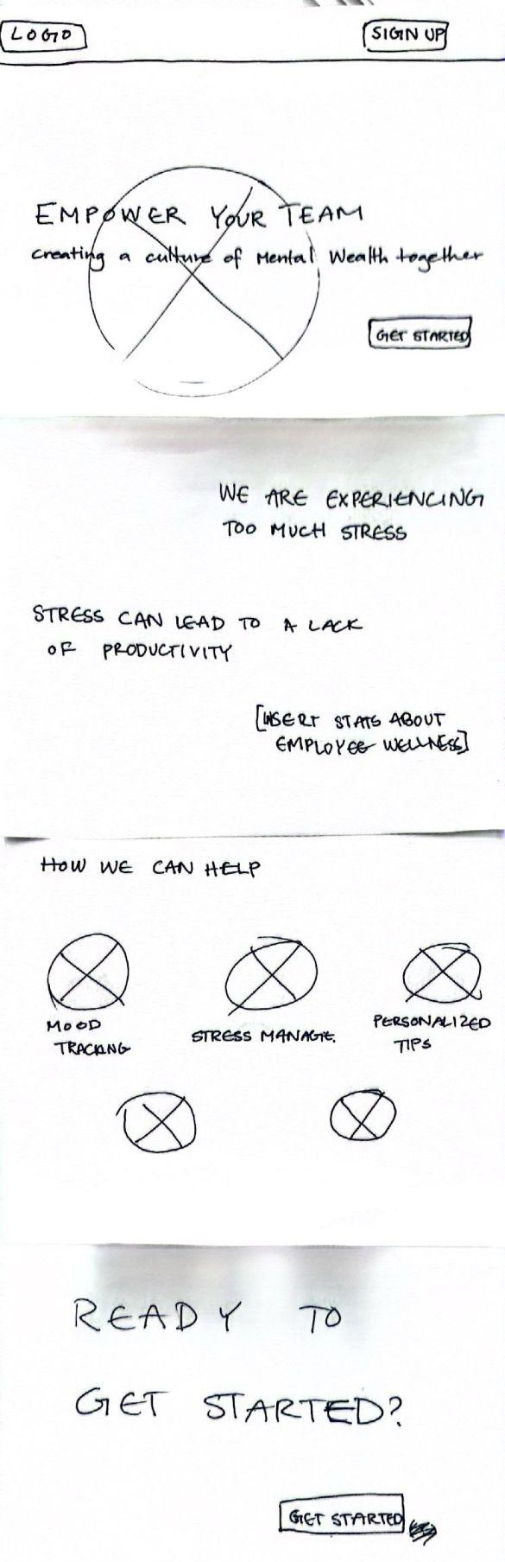
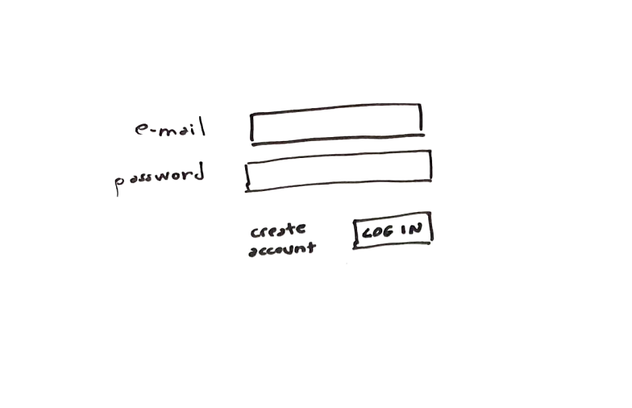
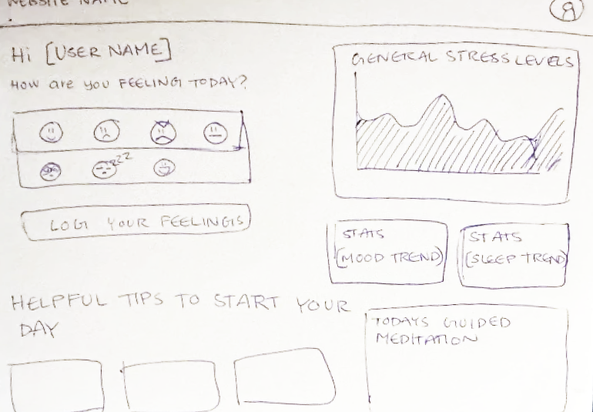
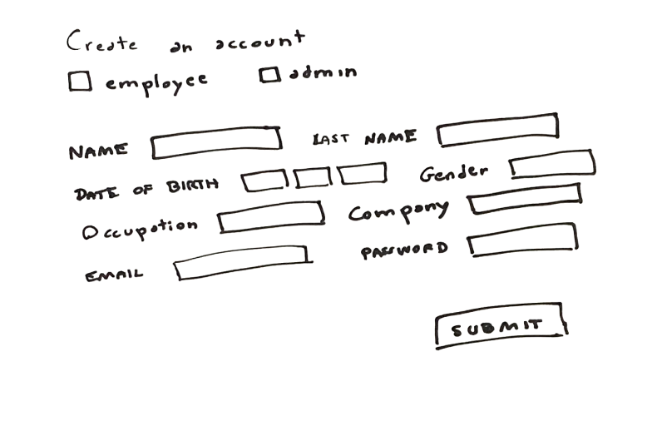
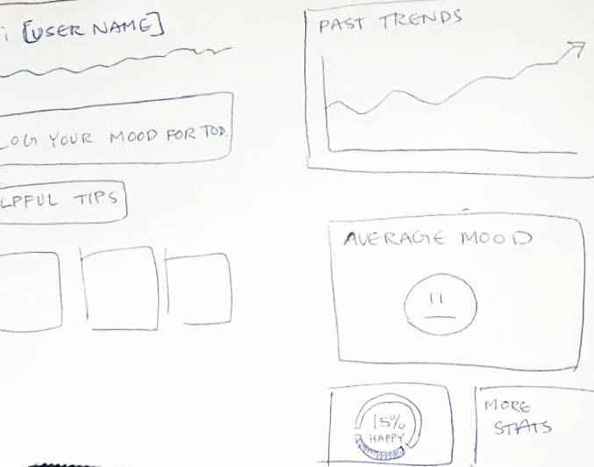
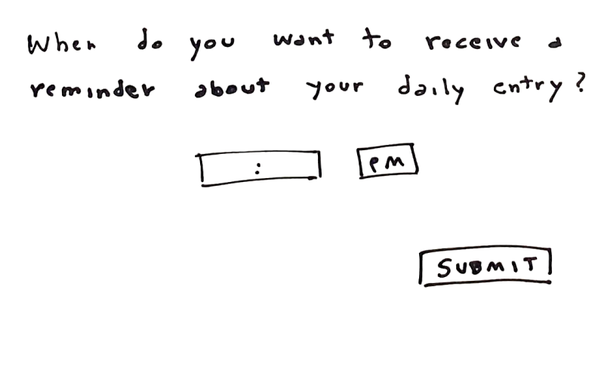
SKETCHES

Slide 17
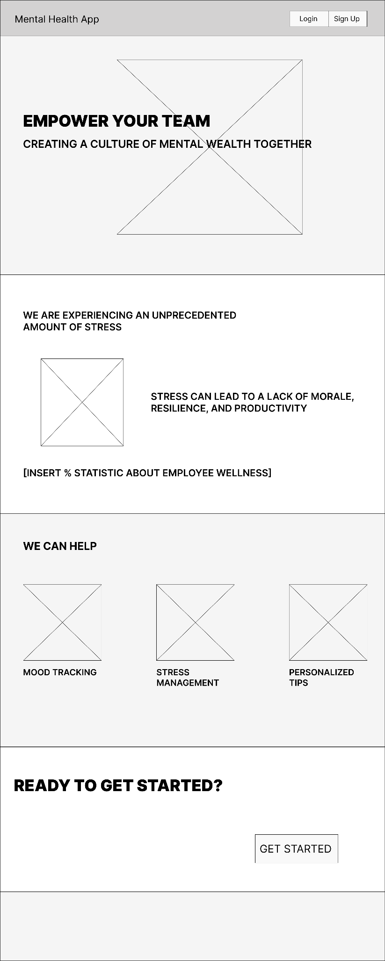
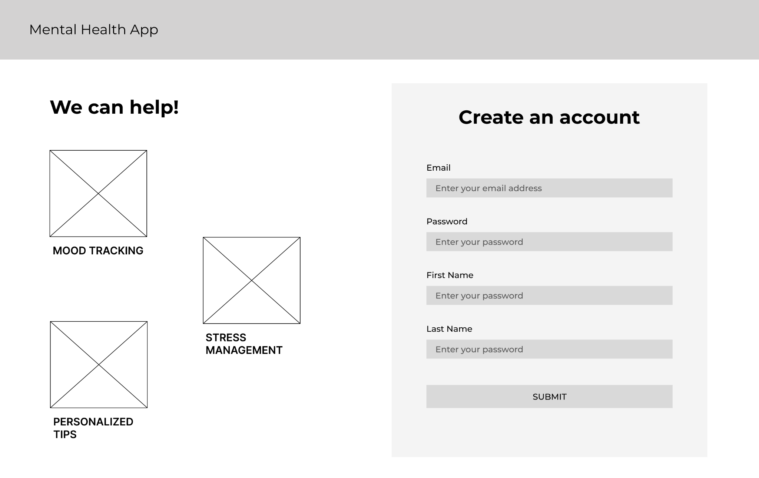
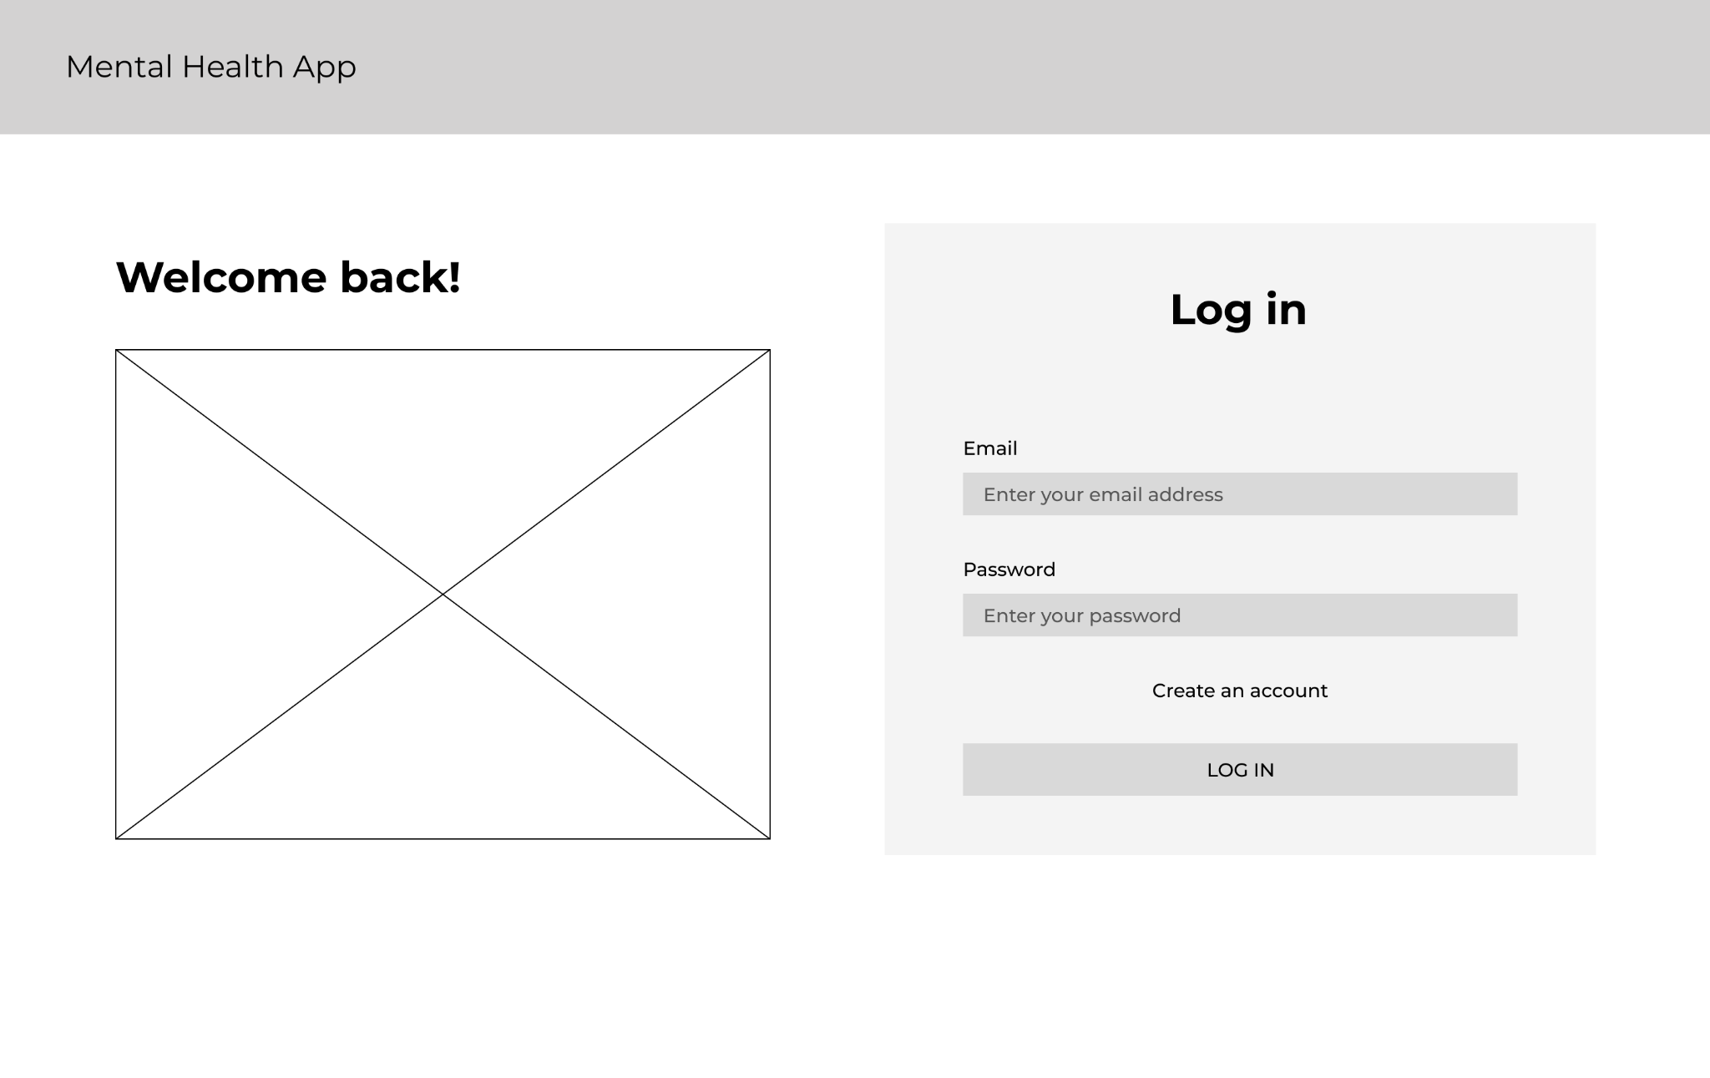
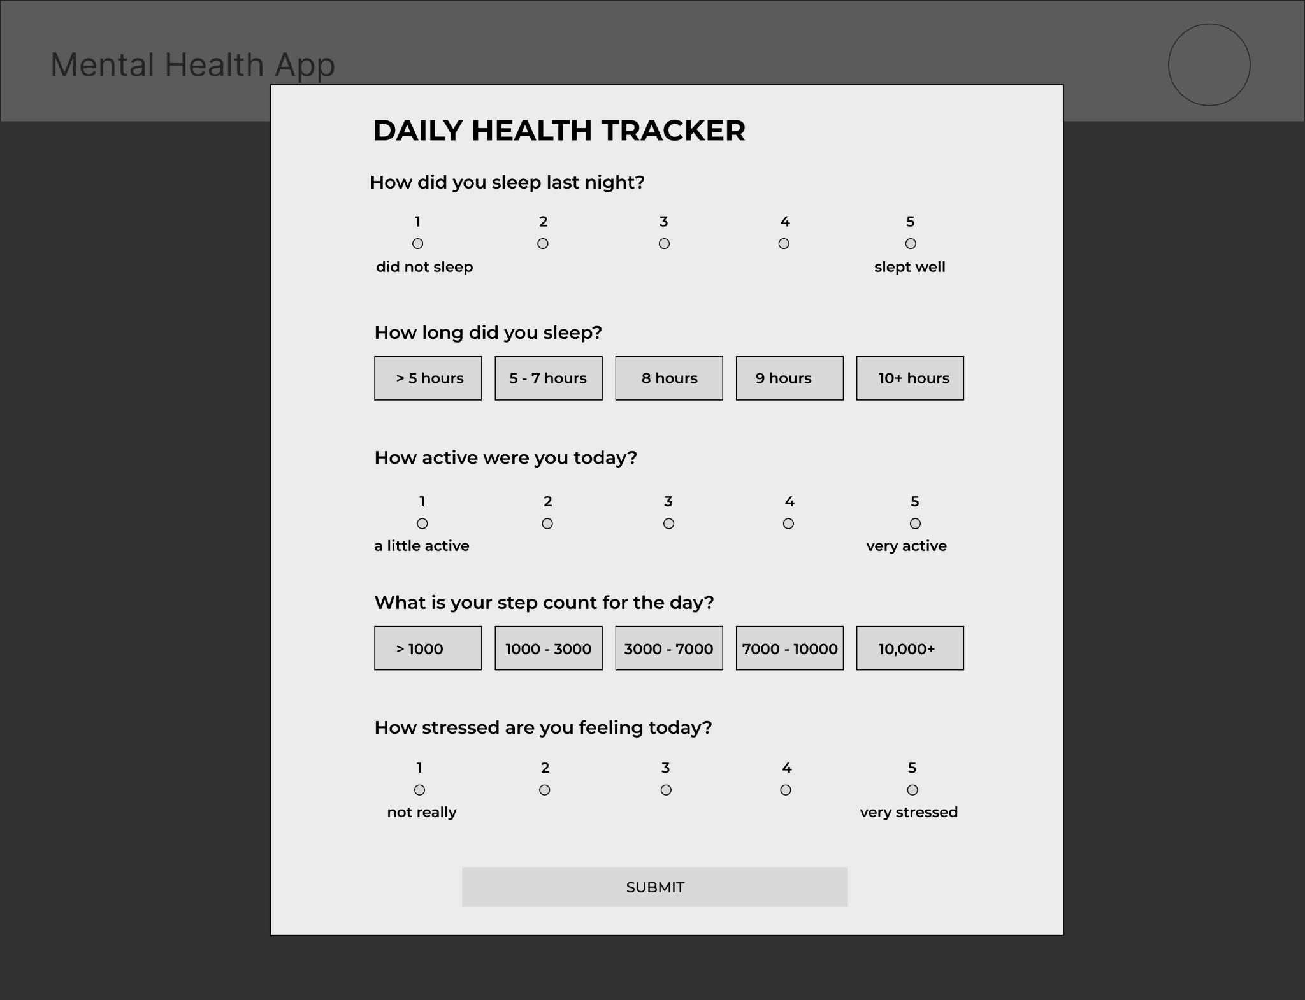
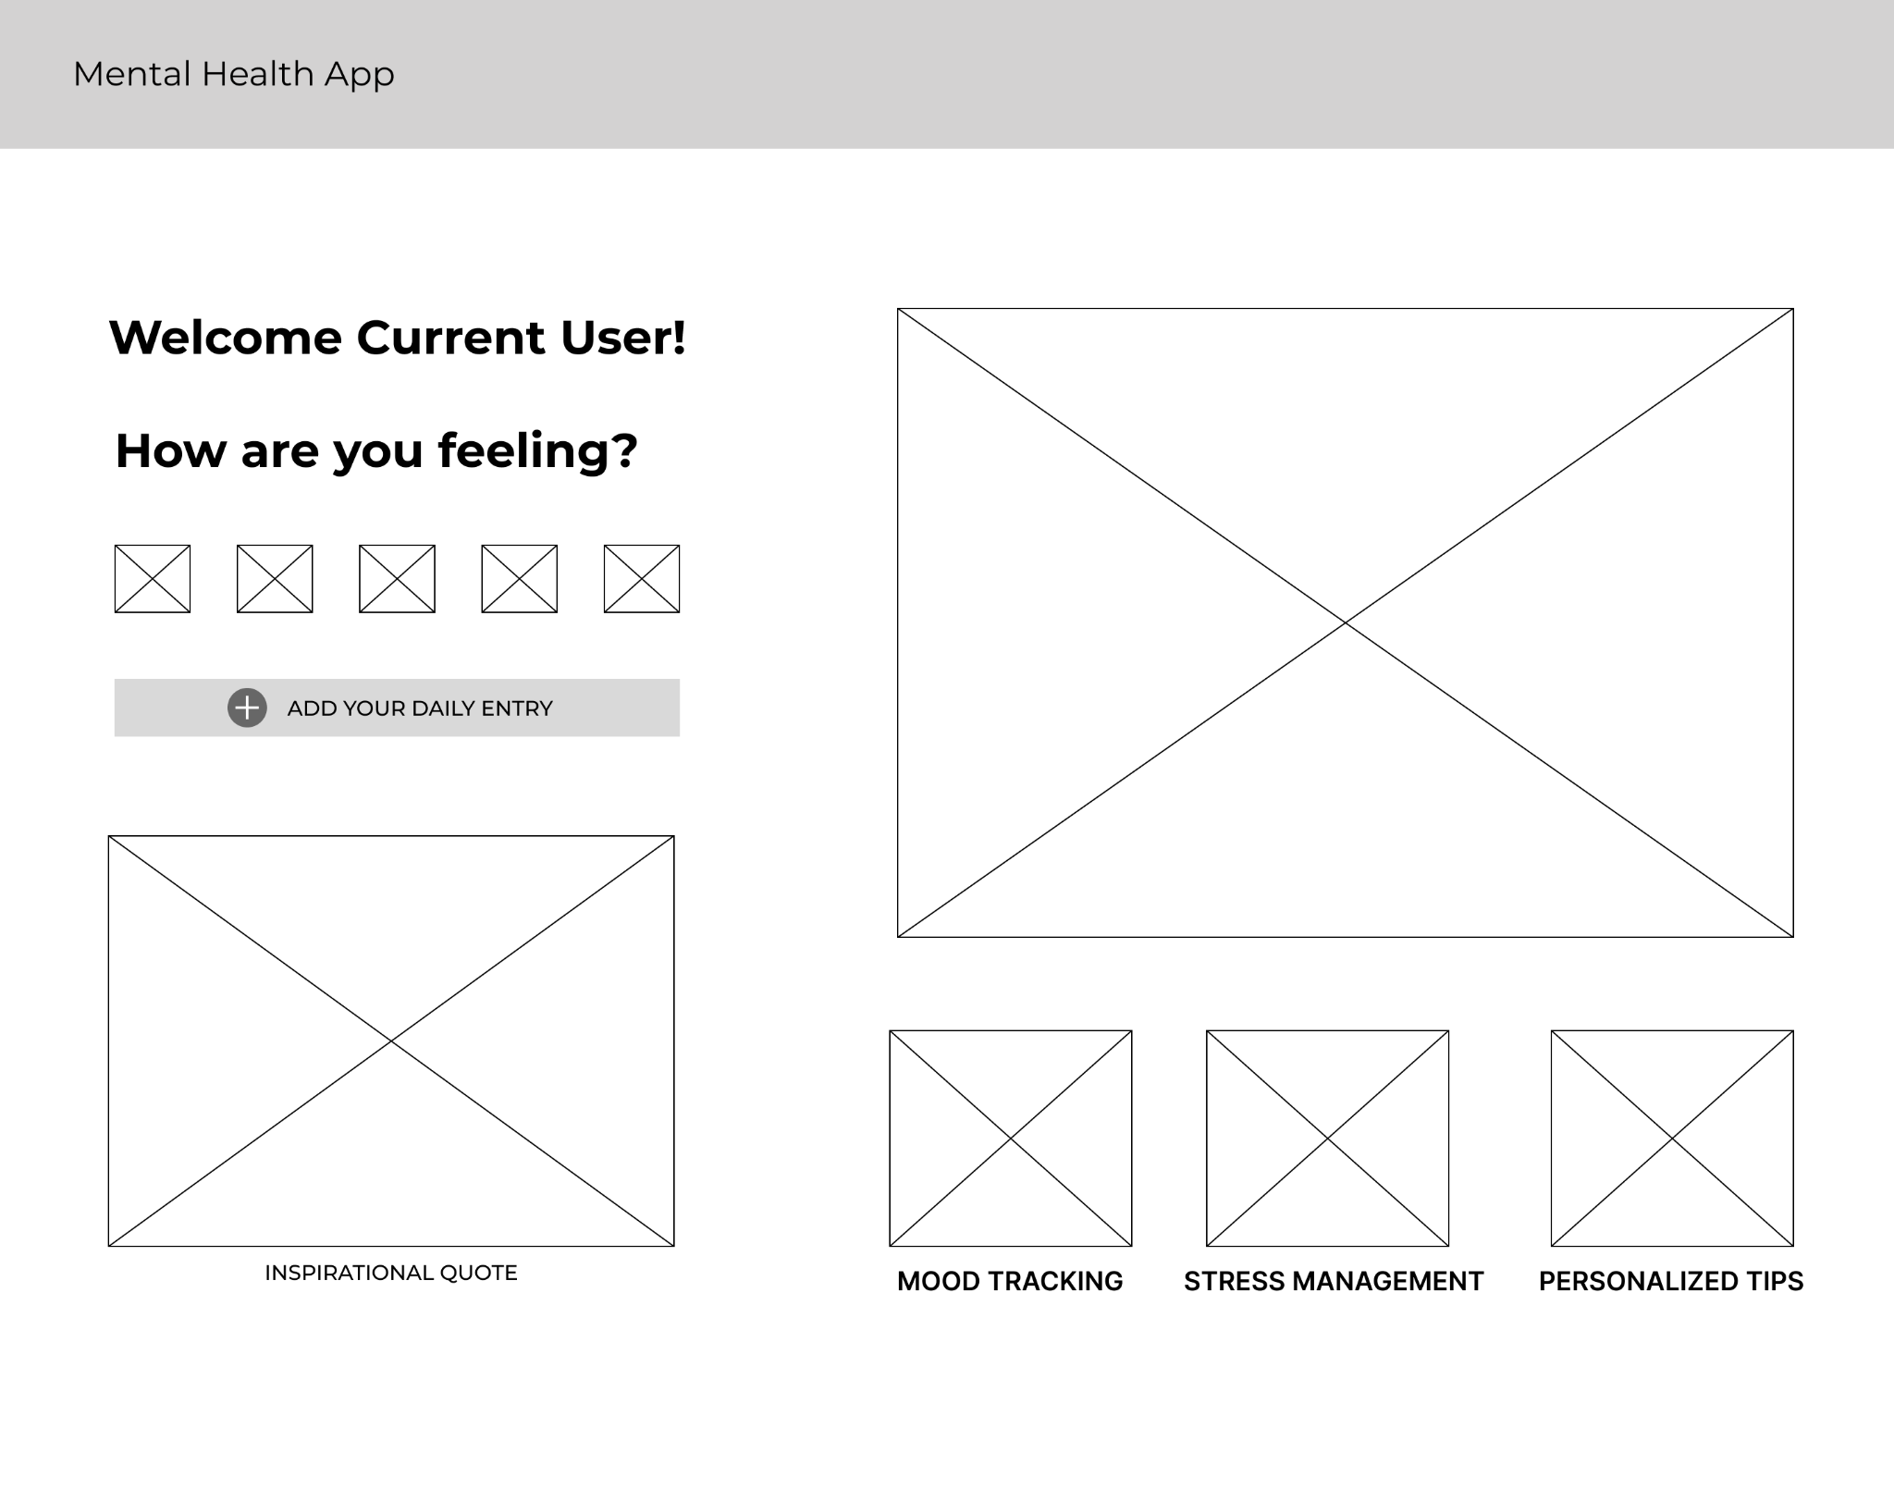
WIREFRAMES

Slide 18
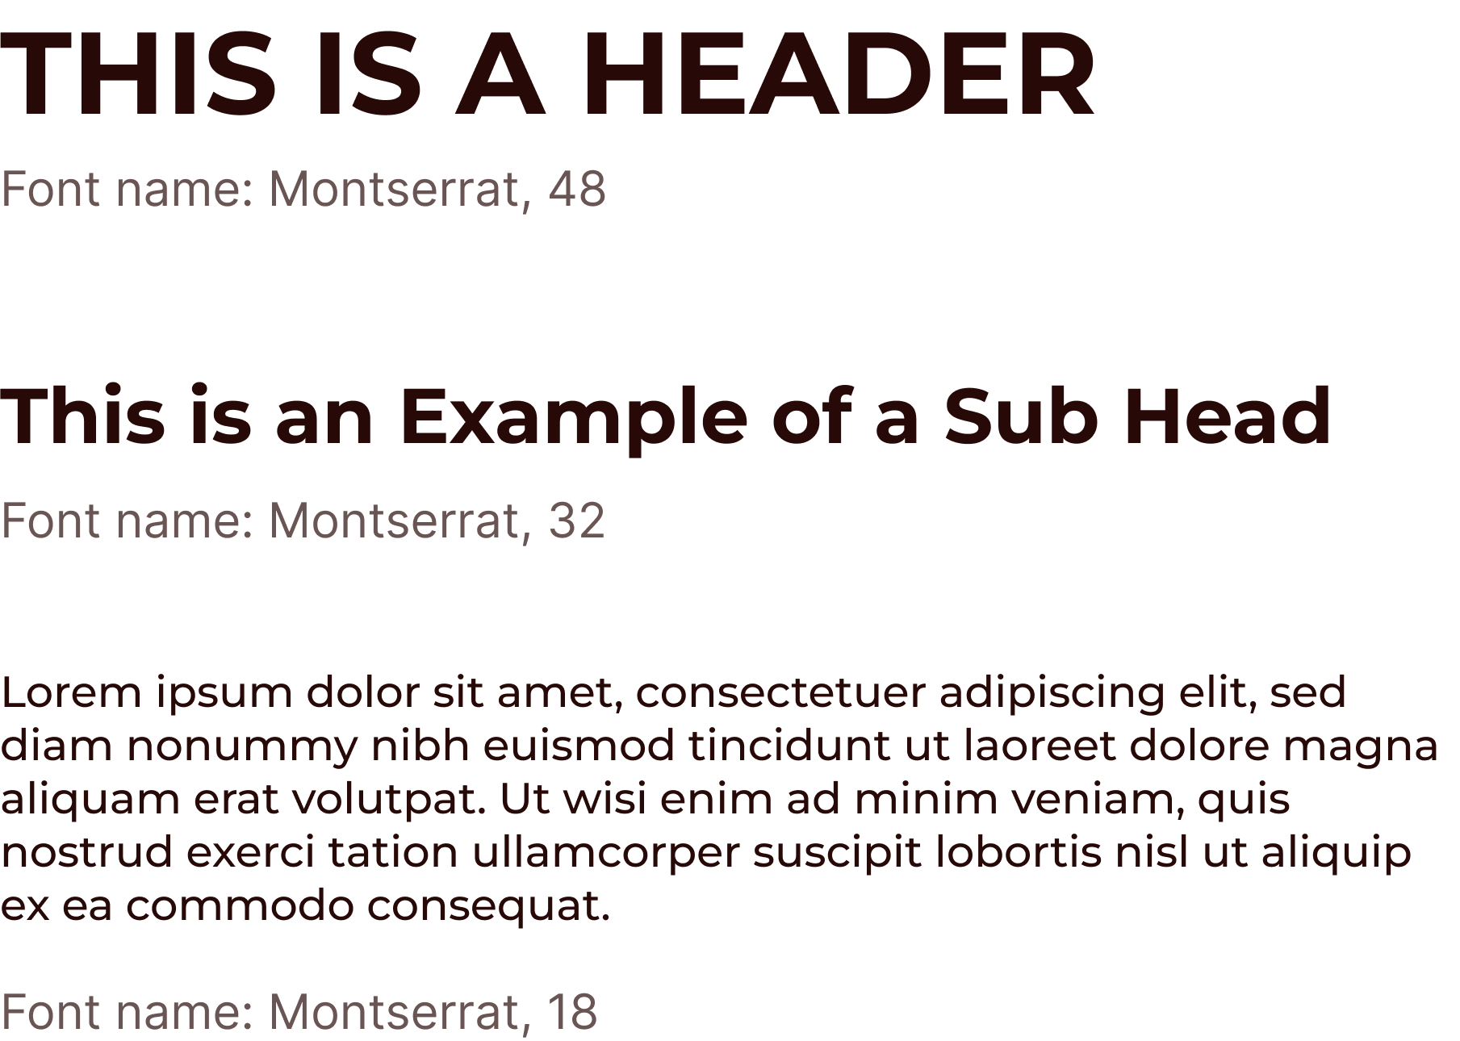
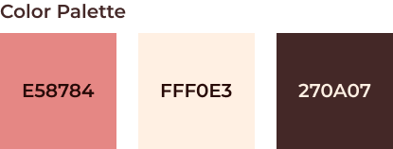
VISUAL STYLING
Pink is linked with feelings of calmness, nurturing, and compassion.
Beige is favored for its calming and neutral properties.
In combination, they bring our website a calming atmosphere for a user to support their own mental health.
Montserrat as the font:
Enhance readability and clarity
Accessible user experience conducive to relaxation and focus.
The logo featuring a face with a heart and mind all connected, embodies the integration of emotions and thoughts essential for mental well-being.
Overall, the logo conveys a holistic approach to mental health, emphasizing support, understanding, and acceptance within a safe and inviting environment.

Slide 19
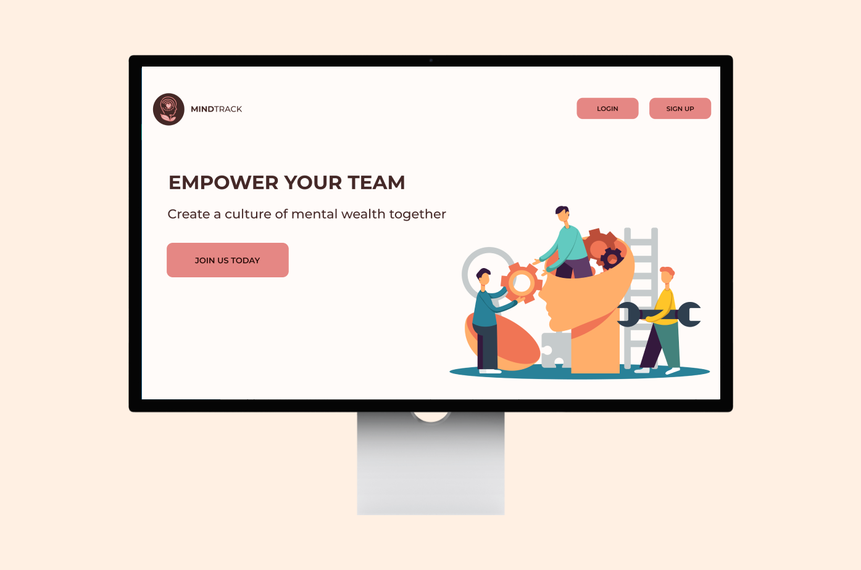
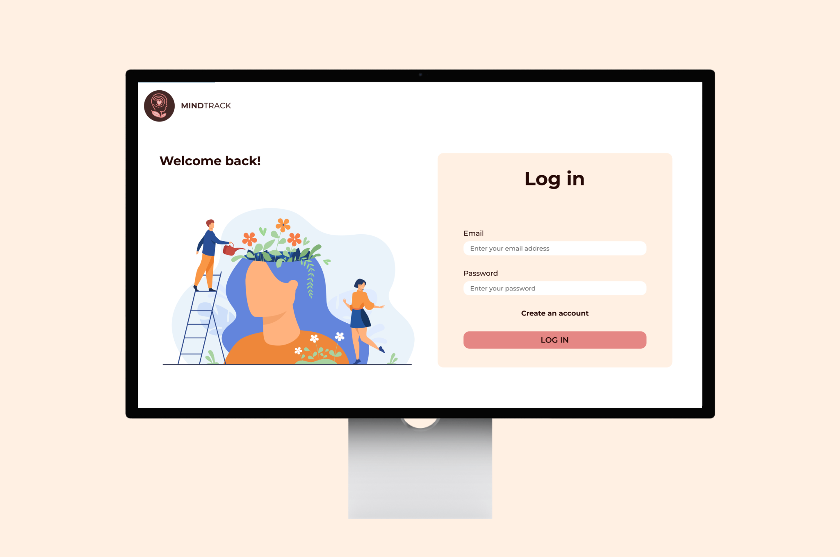
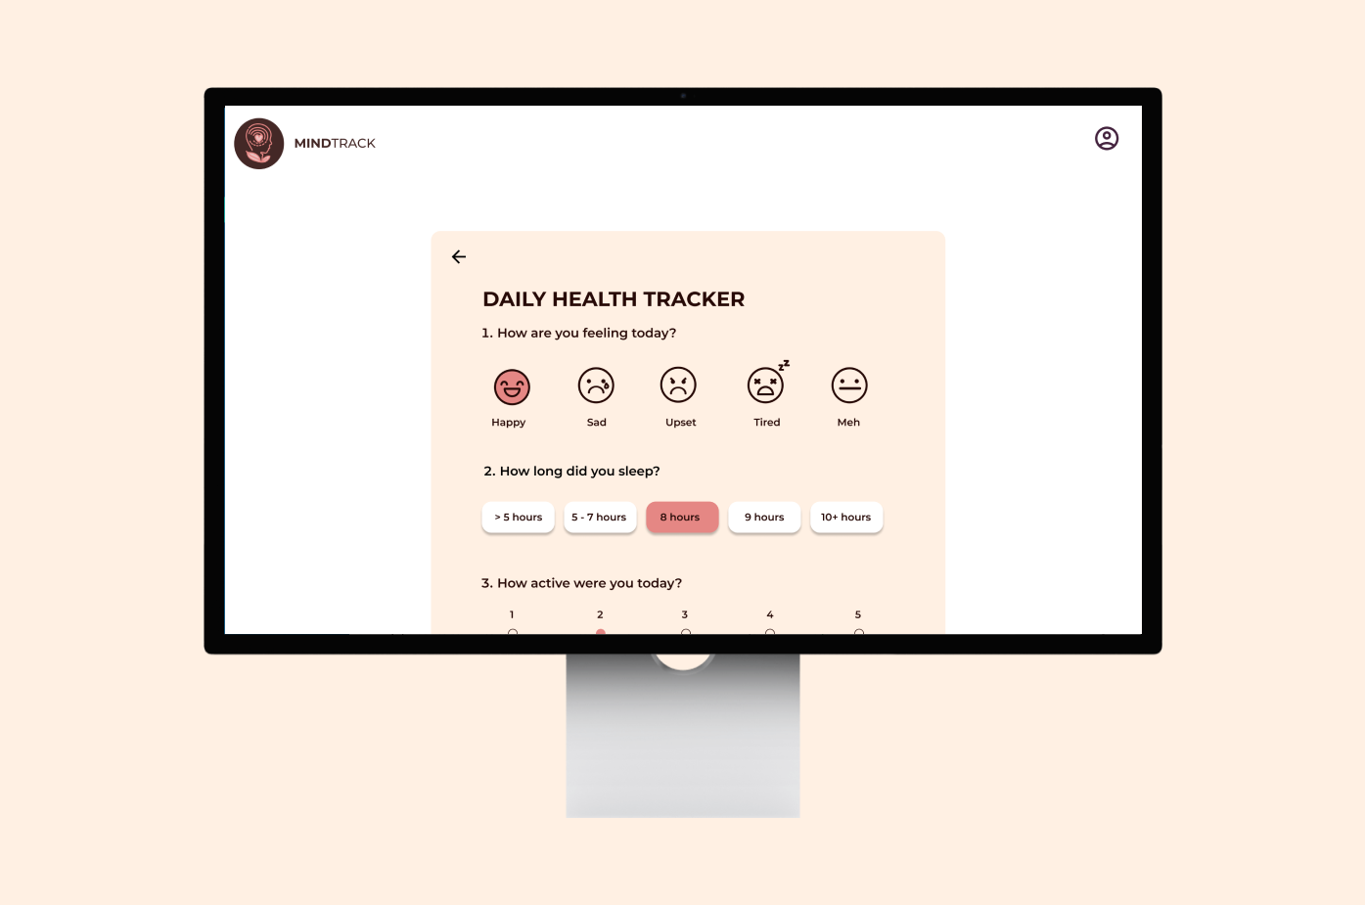
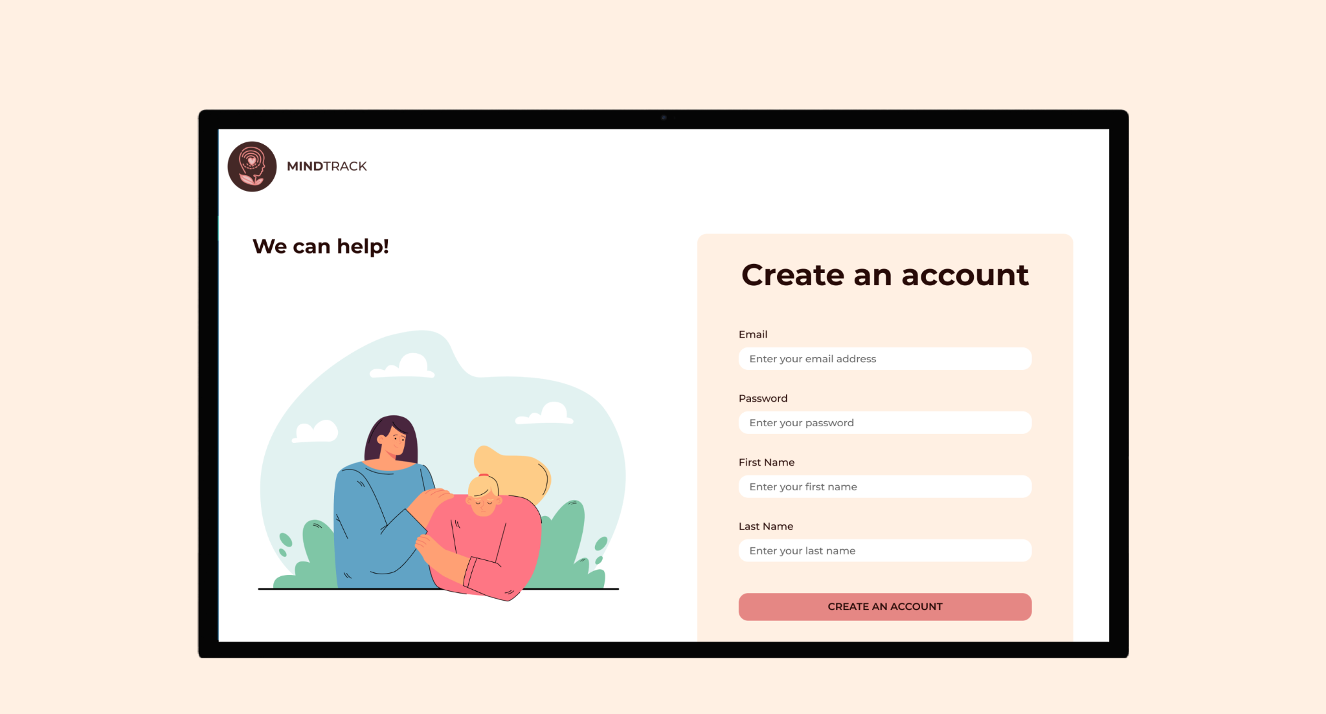
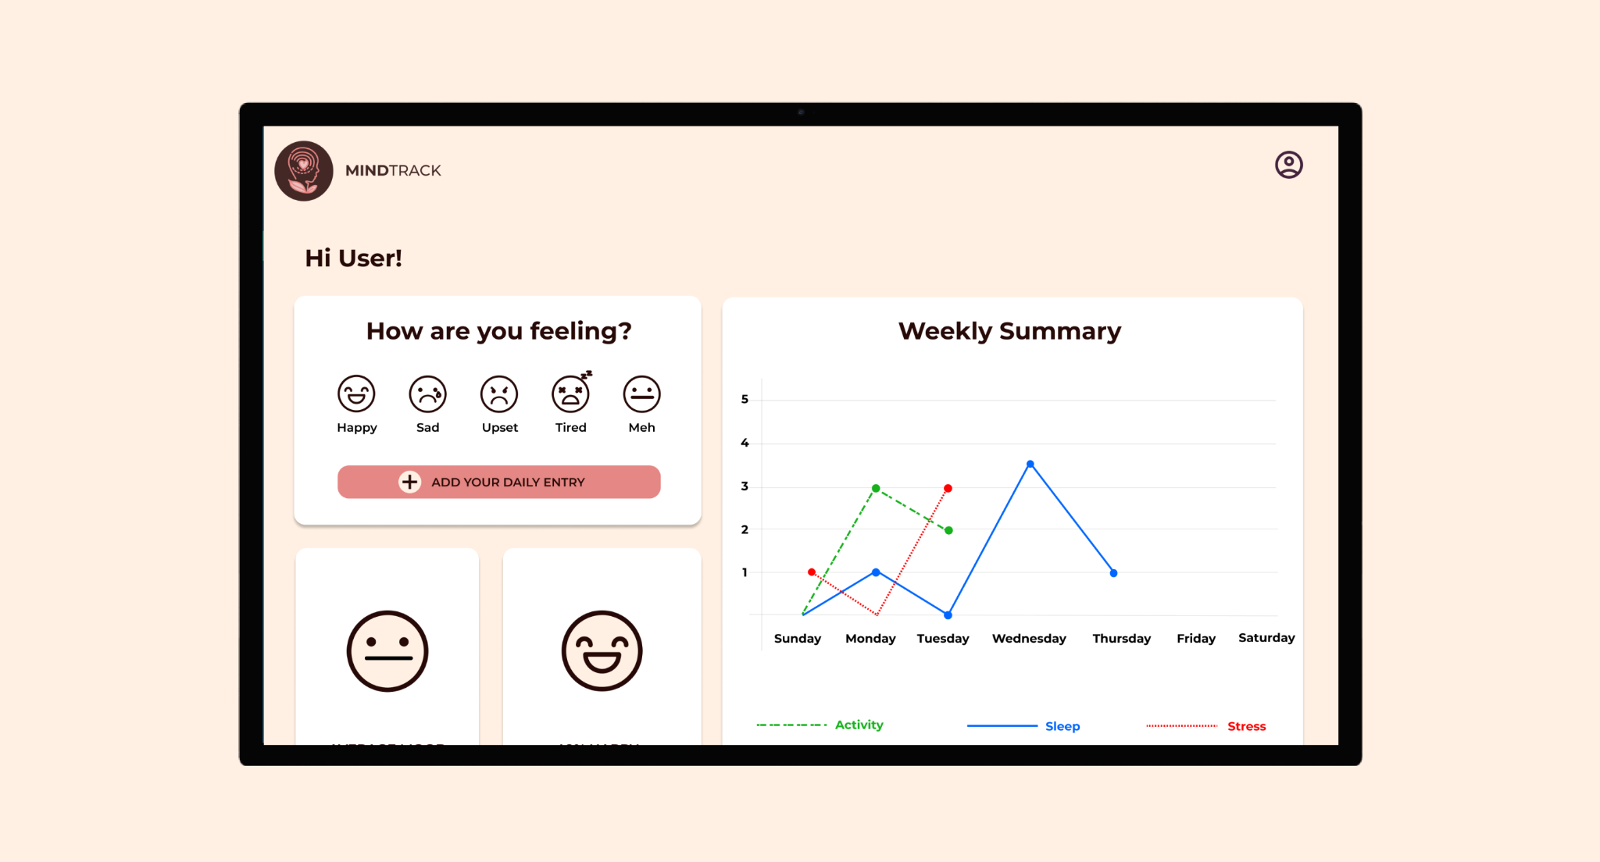
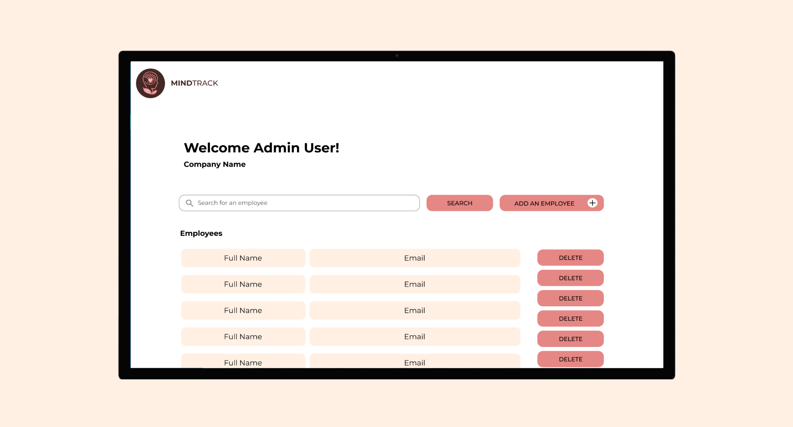
HIGH FIDELITY MOCKUPS

Slide 20
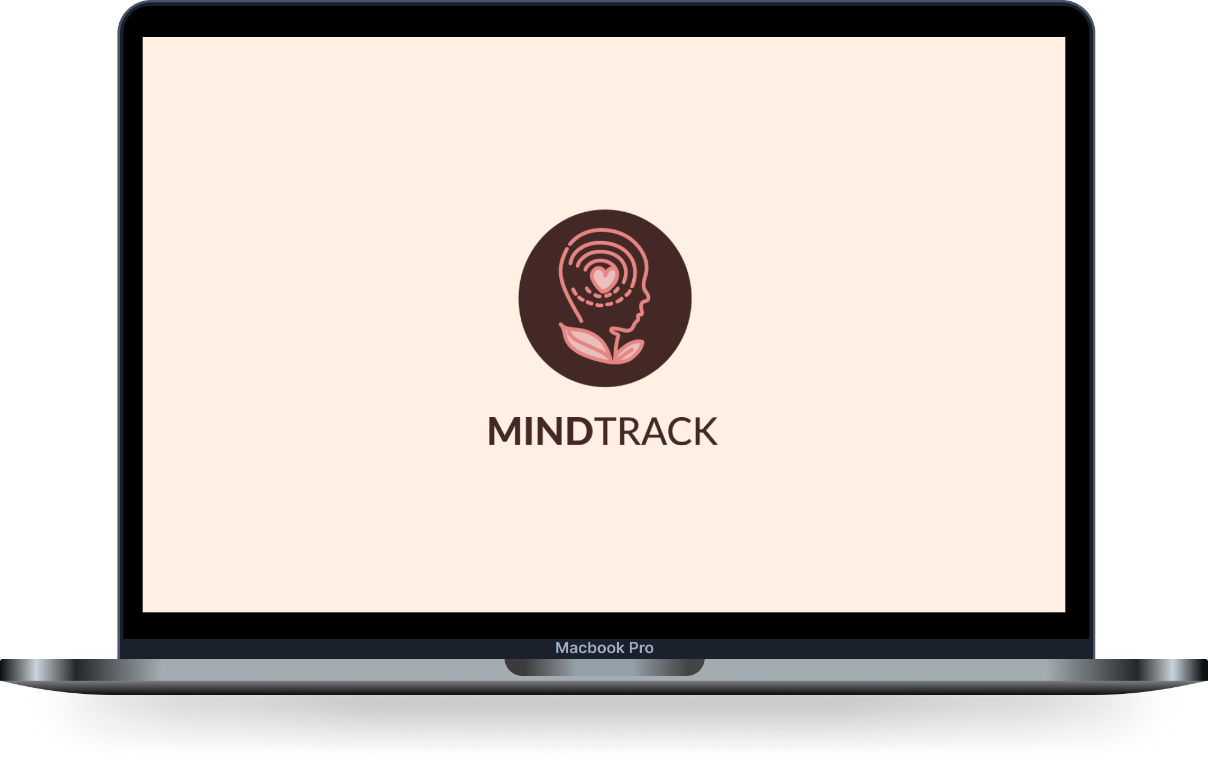






SOFTWARE ENGINEERING
Tools we used:
Front-end:
React, custom CSS, material UI
Back-end:
Node, Express, Knex
https://hackatonwinter24.onrender.com/
Notes:
Used express framework to develop RESTful APIs that handled the requests from the frontend .
Used knex to connect to the database.
Used React to design a user-friendly interface where employees can log in, view their tracked data, and input new data
Combined custom CSS with Material-UI components allowing for a visually appealing design
https://hackatonwinter24.onrender.com/
rachelsmith@gmail.com 4321 (employee with admin)

Slide 21
WHAT WE LEARNED
- As a whole team we learned the value of agile methodologies, iterative progress, and continuous feedback. We were able to foster a dynamic and collaborative environment. Allowing us to rapidly and effectively develop the project.
- As UX Designers, we learned how to scope our design to match the realistic constraints of what could be built in the given time period.
- As a Data Analyst, I learned how to communicate with other members of different fields in order to best allocate their needs to complete our project.
- As Software Engineers, we learned how to identify problems and devise creative solutions
Notes:
As a team we embraced agile methodologies, iterative progress, and continuous feedback to rapidly develop the project collaboratively.

Slide 22
THANK YOU
Notes:
Thank you for your attention and engagement. We welcome any questions or thoughts you may have at this time.

Slide 23
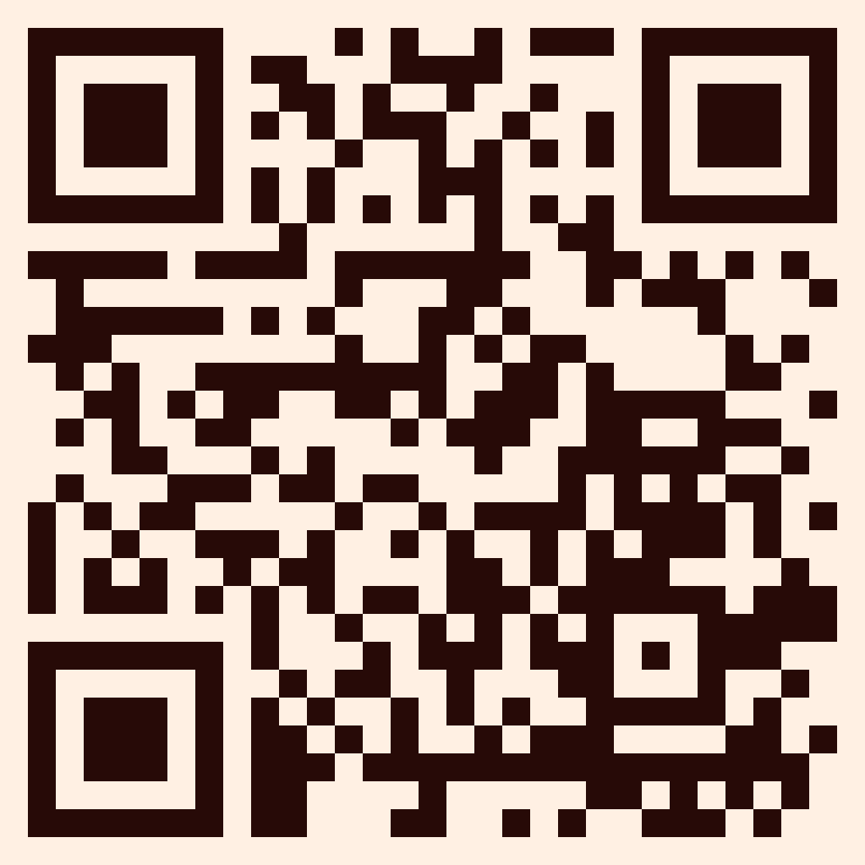
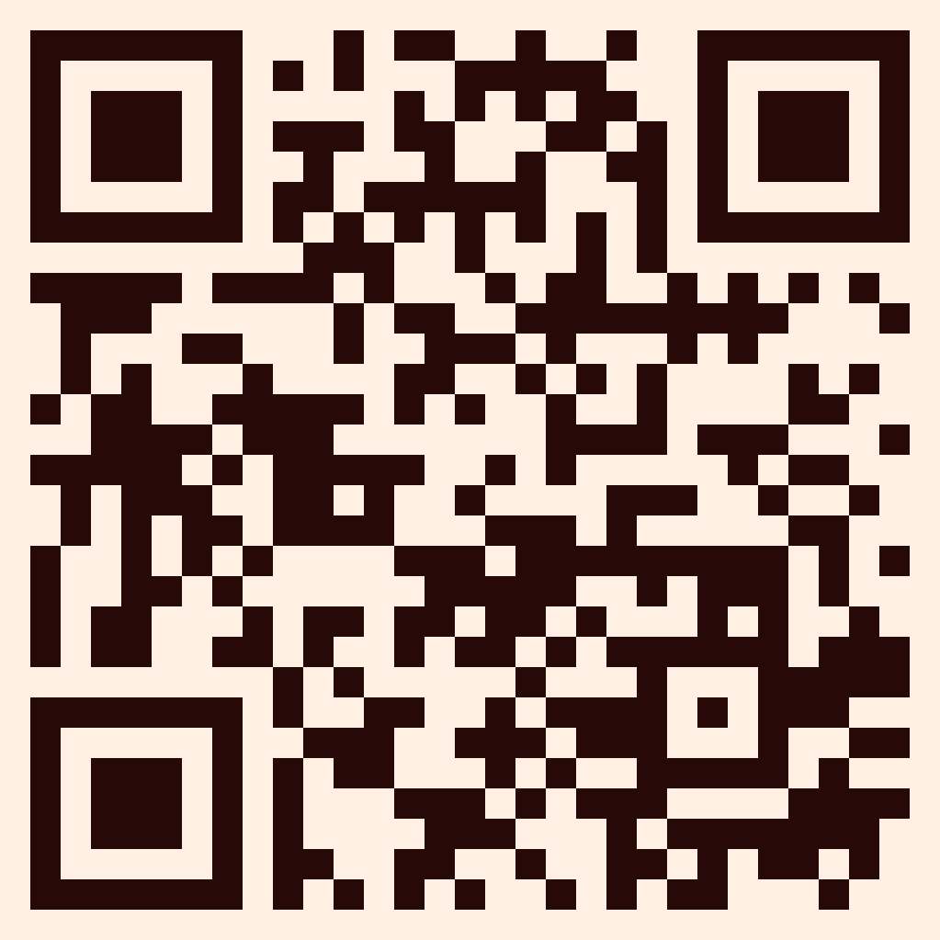
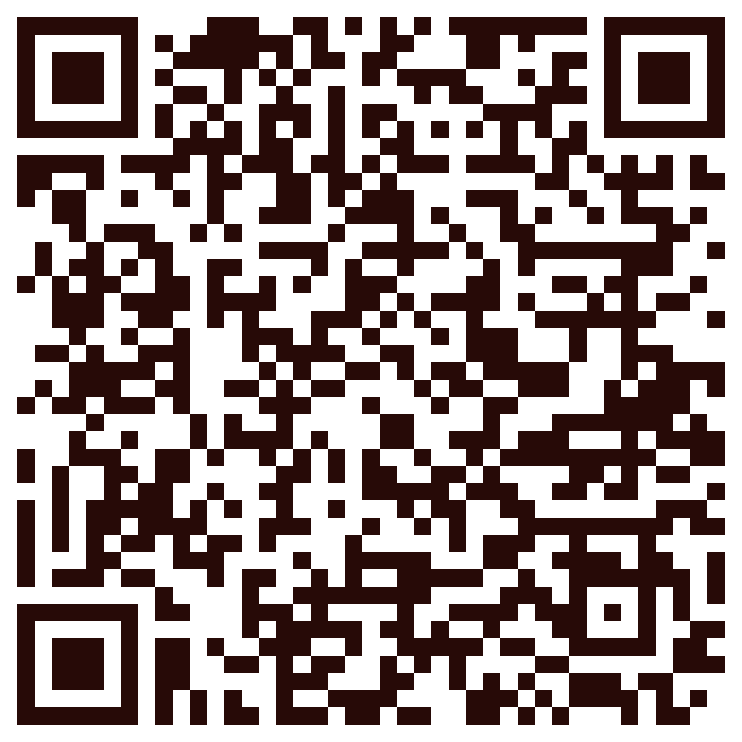
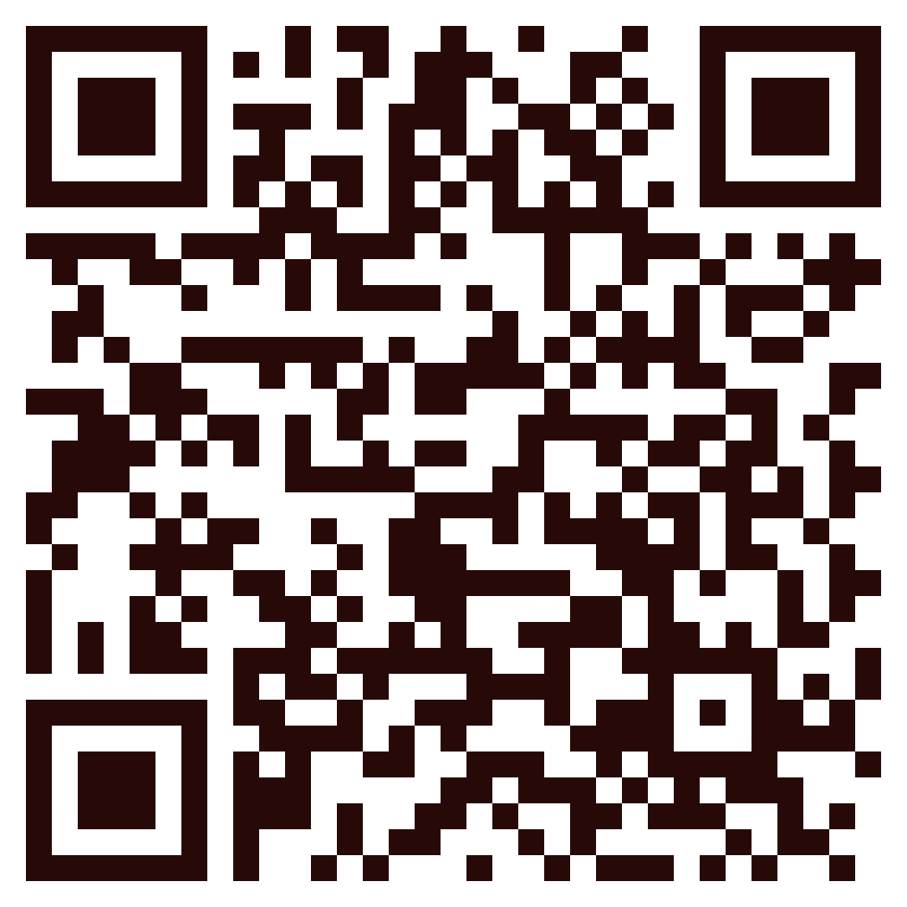
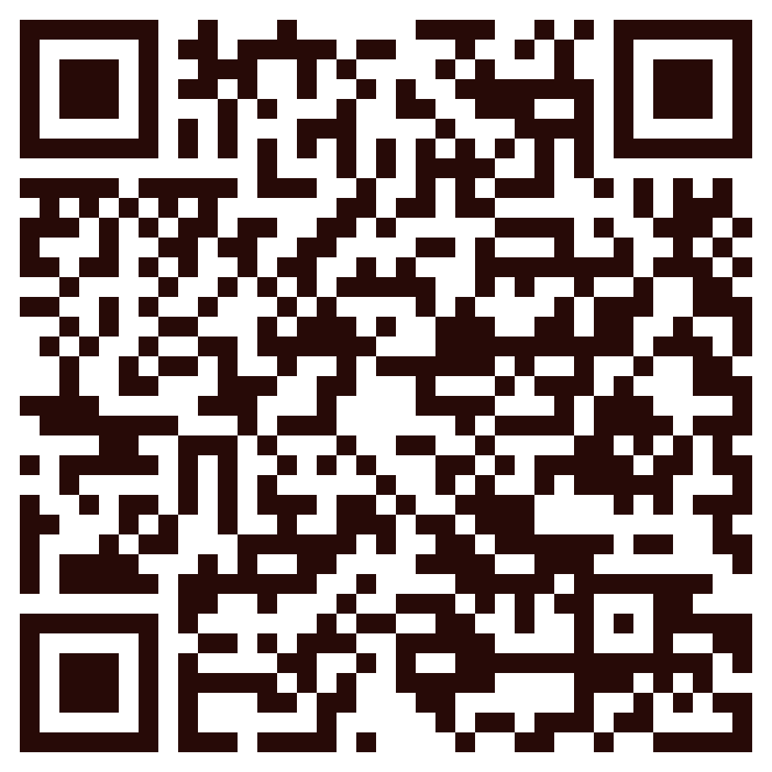
MORE INFORMATION
GIT Repository
Website
Figma
File
Data
Tableau Dashboard
Login as a user:
email: email@testing.com
password: 54321
Login as a user with admin access:
Email: rachelsmith@gmail.com
password: 4321

